Slide 1
Team 5 – Decease Prediction given the symptoms
Team Members #

Slide 2
Our Project Goal
To design and train a machine learning model that can provide disease prognosis with high accuracy, leveraging the different symptoms.
The specific goals are to:
Develop a predictive model that combines data from multiple systems to improve disease prognosis
Achieve a target accuracy of 75% or higher
Create a scalable and interpretable model with APIs that can be integrated into clinical decision support systems

Slide 3
Data Collection
Source of data # Multiple Sources
Type of Data # Health Symptoms and possible disease type
Total number of records # 32168 Records & 154 Columns
Preliminary Observations #
Null Handling
Imputation
Data Merging
Encoding
Feature Selection
Transformations
Drop Records
Encoding

Slide 4
Data Collection
Source of data # Multiple Sources
Type of Data # Health Symptoms and possible disease type
Total number of records # 32168 Records & 154 Columns
Preliminary Observations #
Null Handling
Imputation
Data Merging
Encoding
Feature Selection
Transformations
Drop Records
Encoding

Slide 5
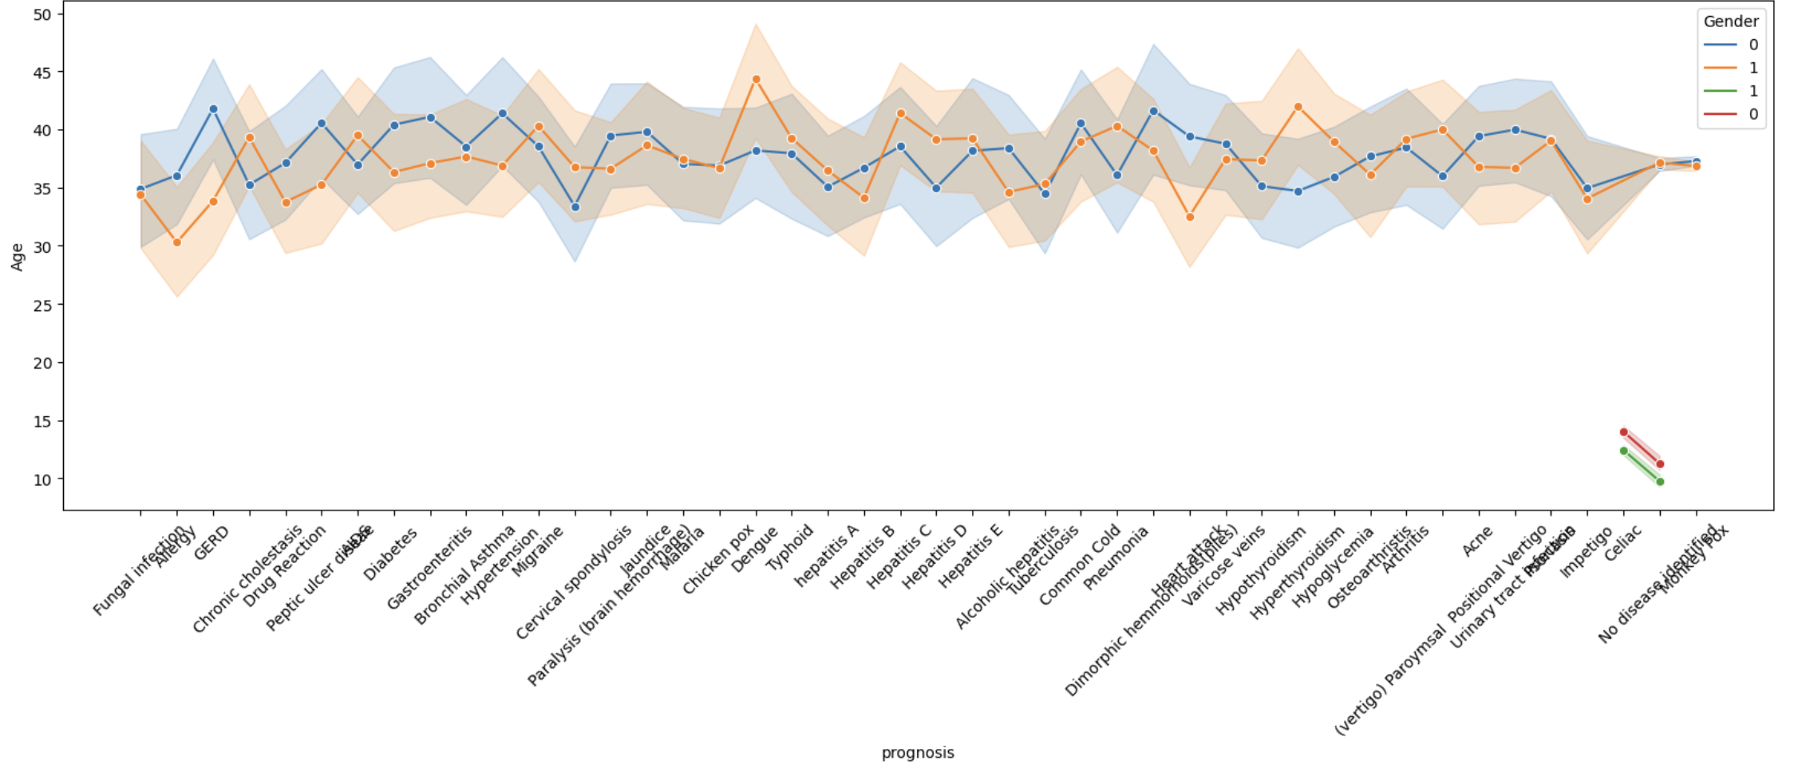
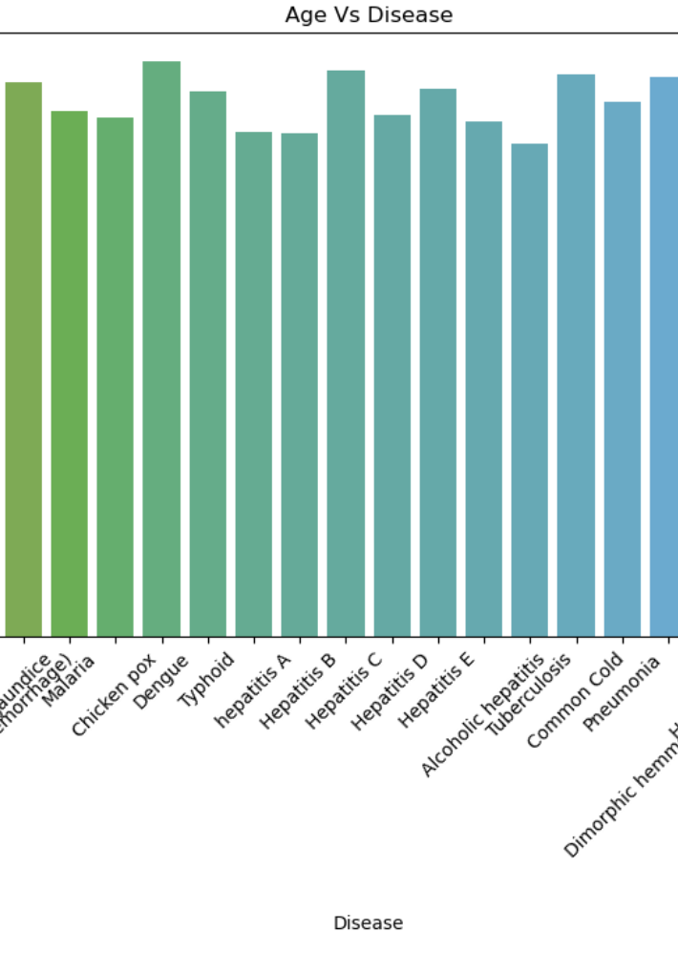
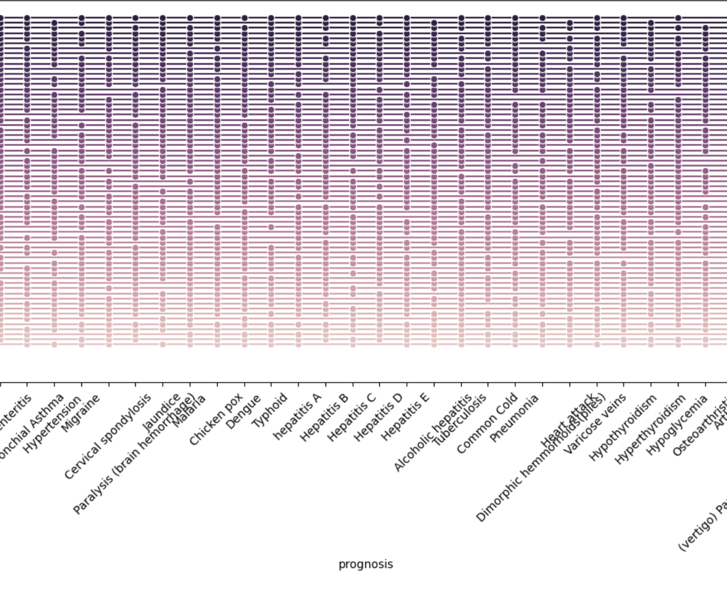
Data Analysis

Slide 6
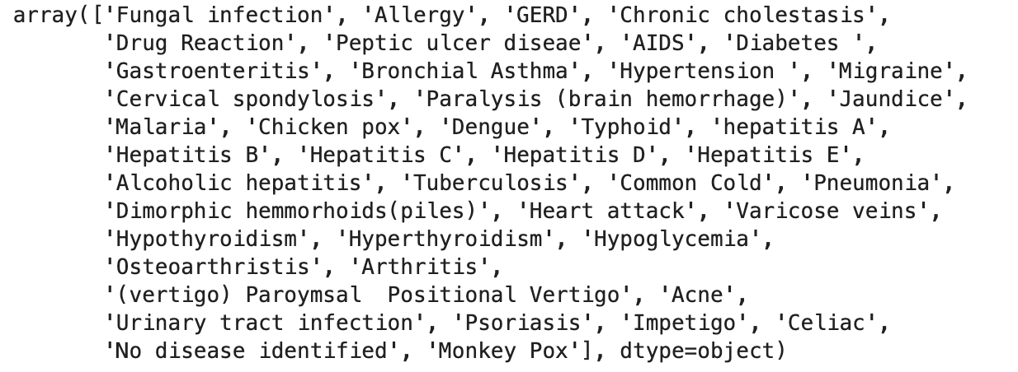
Data Processing
Total Features # 153
Symptoms # True/False ( 1/0)
Drop columns ( Null values)
Imputation of values, Drop Nulls
Final Clean Data set # 32168 Records
Target Value # Disease Type
Total Number of unique Disease # 44

Slide 7
Model Training & Evaluation
Models Trained
Decision Tree
Random Forest
Naive Bayes”
SVC
Model | Performance Matrics
Decision Tree | Accuracy: 0.6835364337229545 Precision: 0.684987278886819 Recall: 0.6835364337229545 F1 Score: 0.6842353385550427
Random Forest | Accuracy: 0.6989554837105197 Precision: 0.6957144866704396 Recall: 0.6989554837105197 F1 Score: 0.6971421163448005
Naive Bayes | Accuracy: 0.717607560308381 Precision: 0.8195452905119949 Recall: 0.717607560308381 F1 Score: 0.6164818492572341
SVC | Accuracy: 0.5778413330017409 Precision: 0.5650547637140237 Recall: 0.5778413330017409 F1 Score: 0.4402081764843686

Slide 8
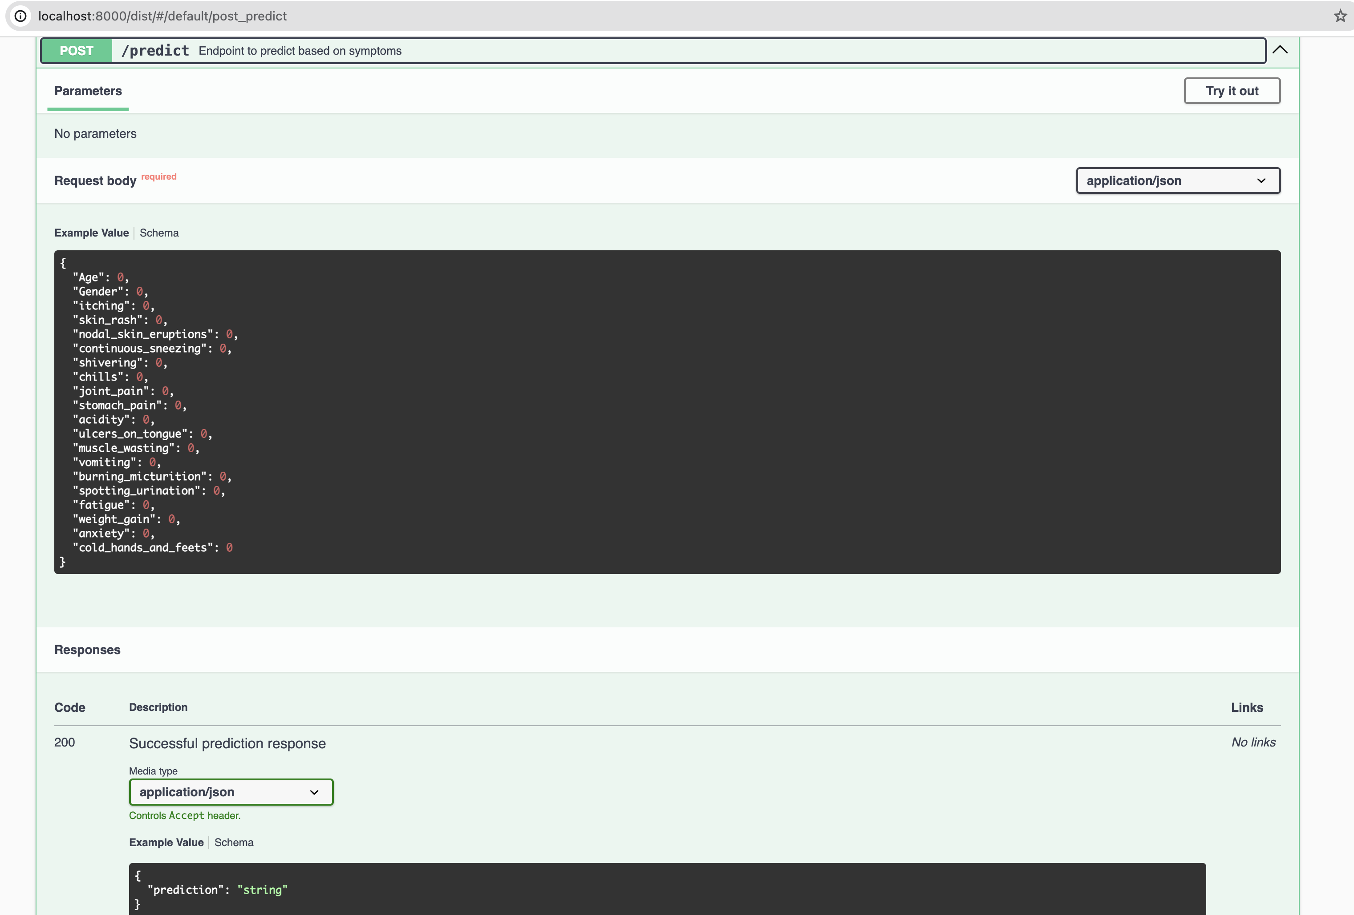
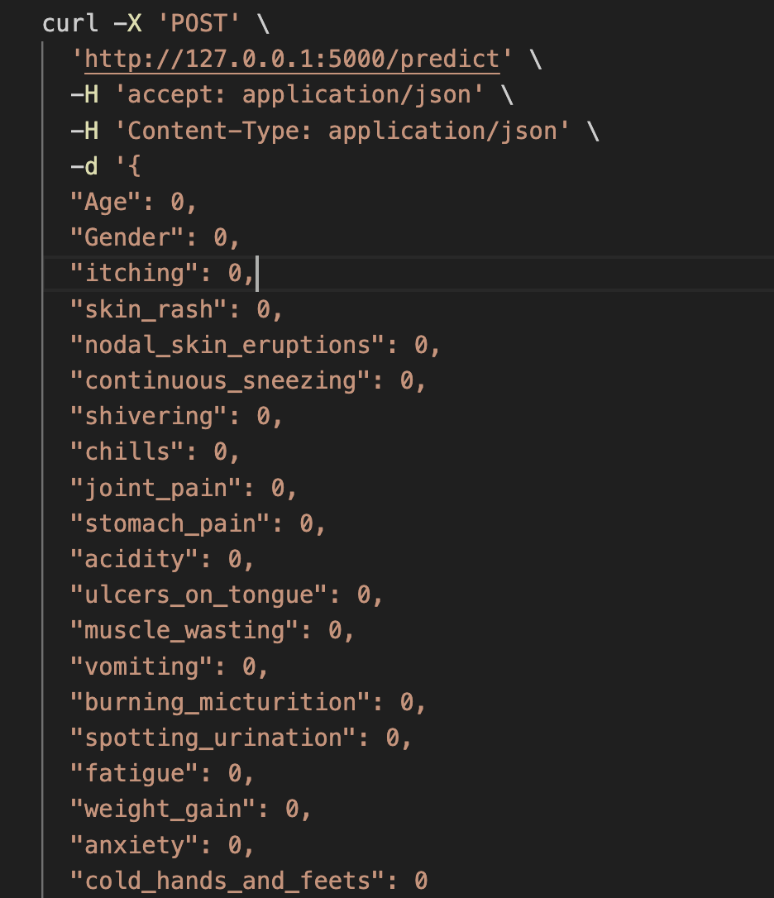
MODEL DEPLOYMENT
Naive Bayes model performance is better than the other models.
Model deployed and enabled via API for Prediction purposes
Pickle library to create the final pickle file to enable model via API.
Flask library to enable Model via rest API
Swagger UI to execute the model

Slide 9
Demo
THANK YOU

